Slide 1
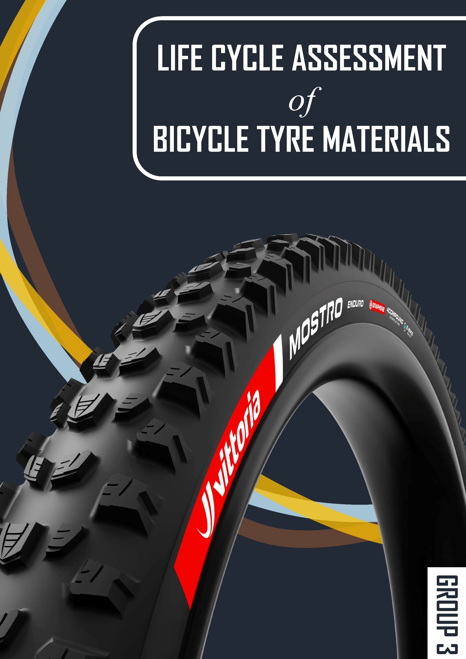
LIFE CYCLE ASSESSMENT OF BICYCLE TYRE MATERIALS GROUP THREE (3)
OHENE LAWRENCIA

Slide 2
GOAL AND SCOPE
The goal of the LCA study is to compare and assess the environmental impacts of different bicycle tire materials, with a focus of Global Warming Potential.
Scope: A gate to gate approach focusing on the production process.
Functional unit: Producing 1,000 hybrid bicycle tyres with a mass of 0.42 kg each per year
Notes:
The type of tyre we are using according to ISO 5775 is type 700C * 28C where the 700C indicates a rim diameter of 622mm and and 28C a width of 28mm

Slide 3
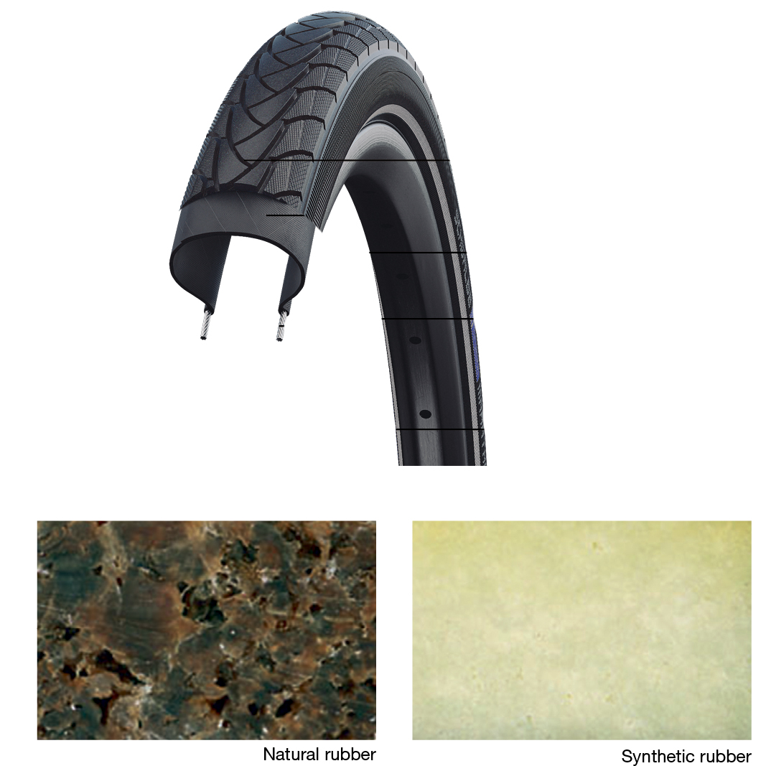
BICYCLE TIRE COMPOSITION
COMPONENTS | PERCENTAGE BY MASS
Carcass | 20-30 %
Bead Core | 5-10 %
Rubber Tread | 40-60 %

Slide 4
RUBBER TREAD COMPOSITION
COMPONENT | PERCENTAGE (%)
Natural Rubber | 20-30
Synthetic Rubber | 40-50
Carbon Black | 20-30
Silica | 5-10
Chemical Additives | 5-10

Slide 5
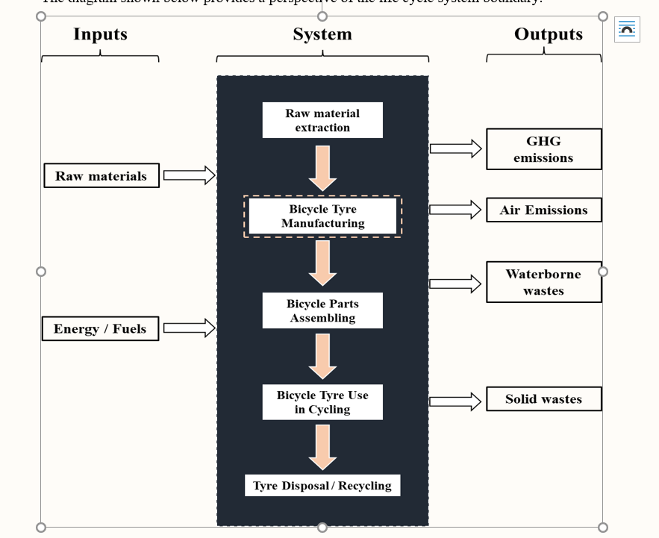
GOAL AND SCOPE

Slide 6
SYNTHETIC RUBBERS TYPICALLY USED
Polybutadiene
Acrylonitrile-butadiene-styrene copolymer
Styrene-Acrylonitrile copolymer
Isobutylene-isoprene Halogenated Rubber
Isobutylene-isoprene Rubber
Styrene Butadiene Rubber

Slide 7
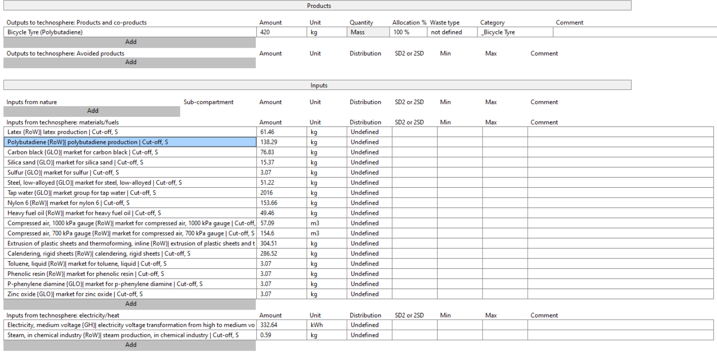
INVENTORY ANALYSIS (INPUT)

Slide 8
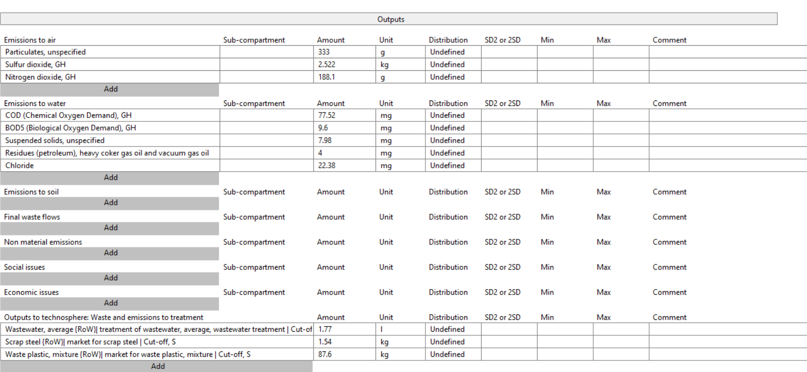
INVENTORY ANALYSIS (OUTPUT)

Slide 9
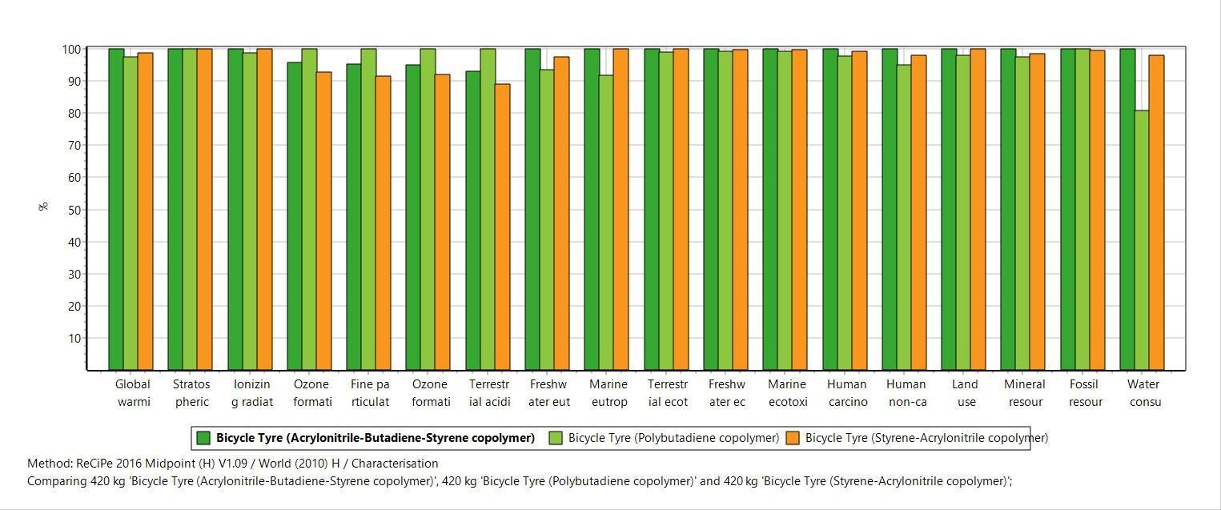
IMPACT ASSESSMENT (INPUT)

Slide 10
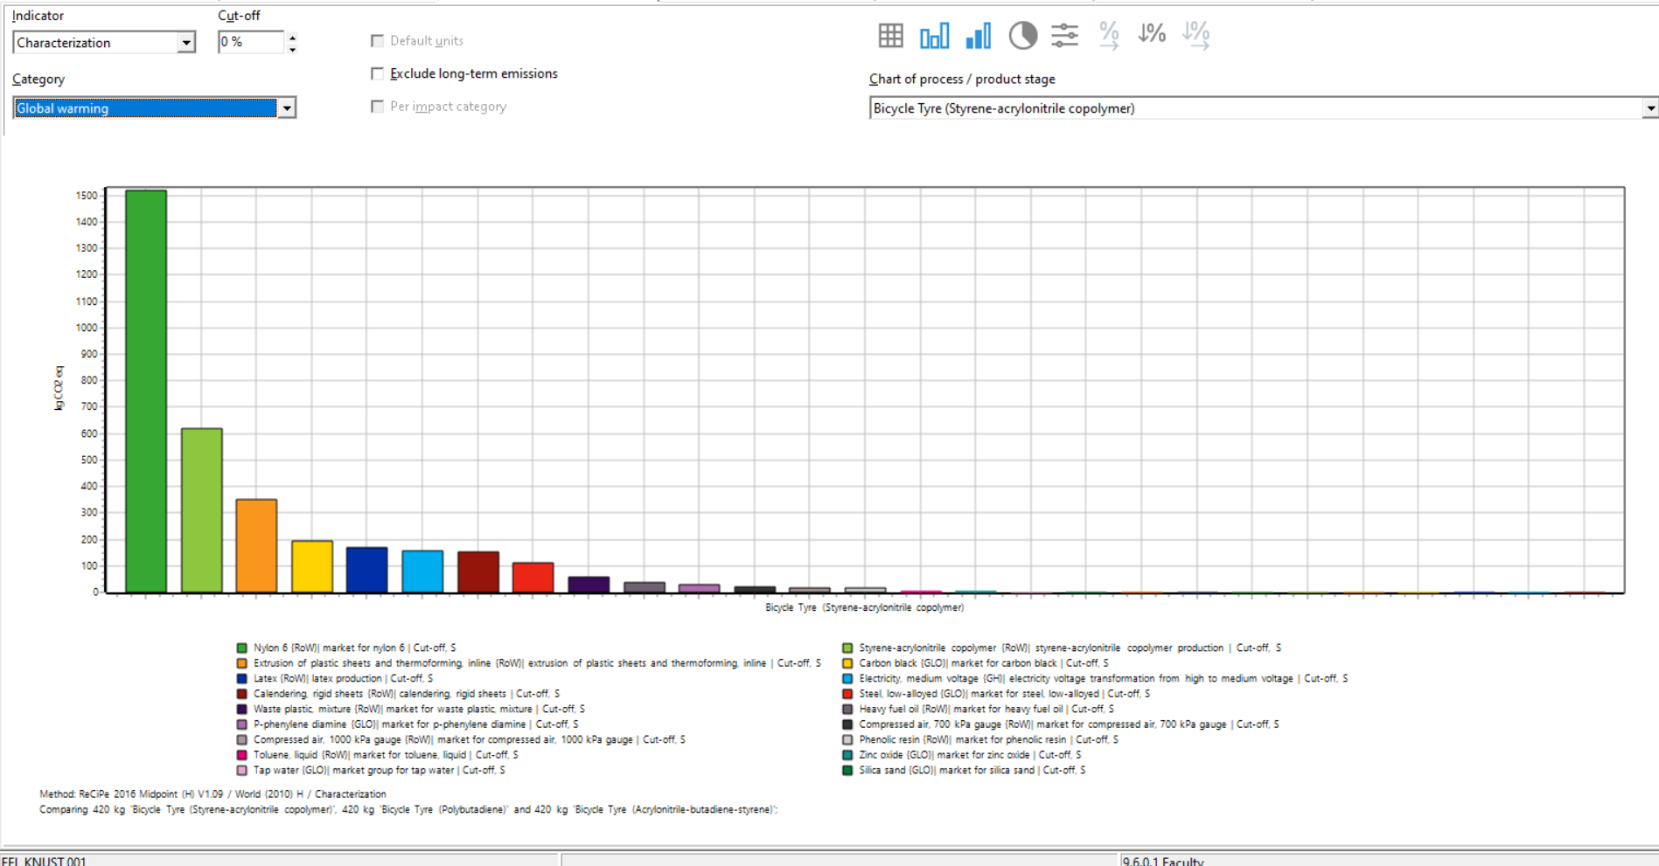
GLOBAL WARMING CONTRIBUTIONS, POLYBUTADIENE

Slide 11
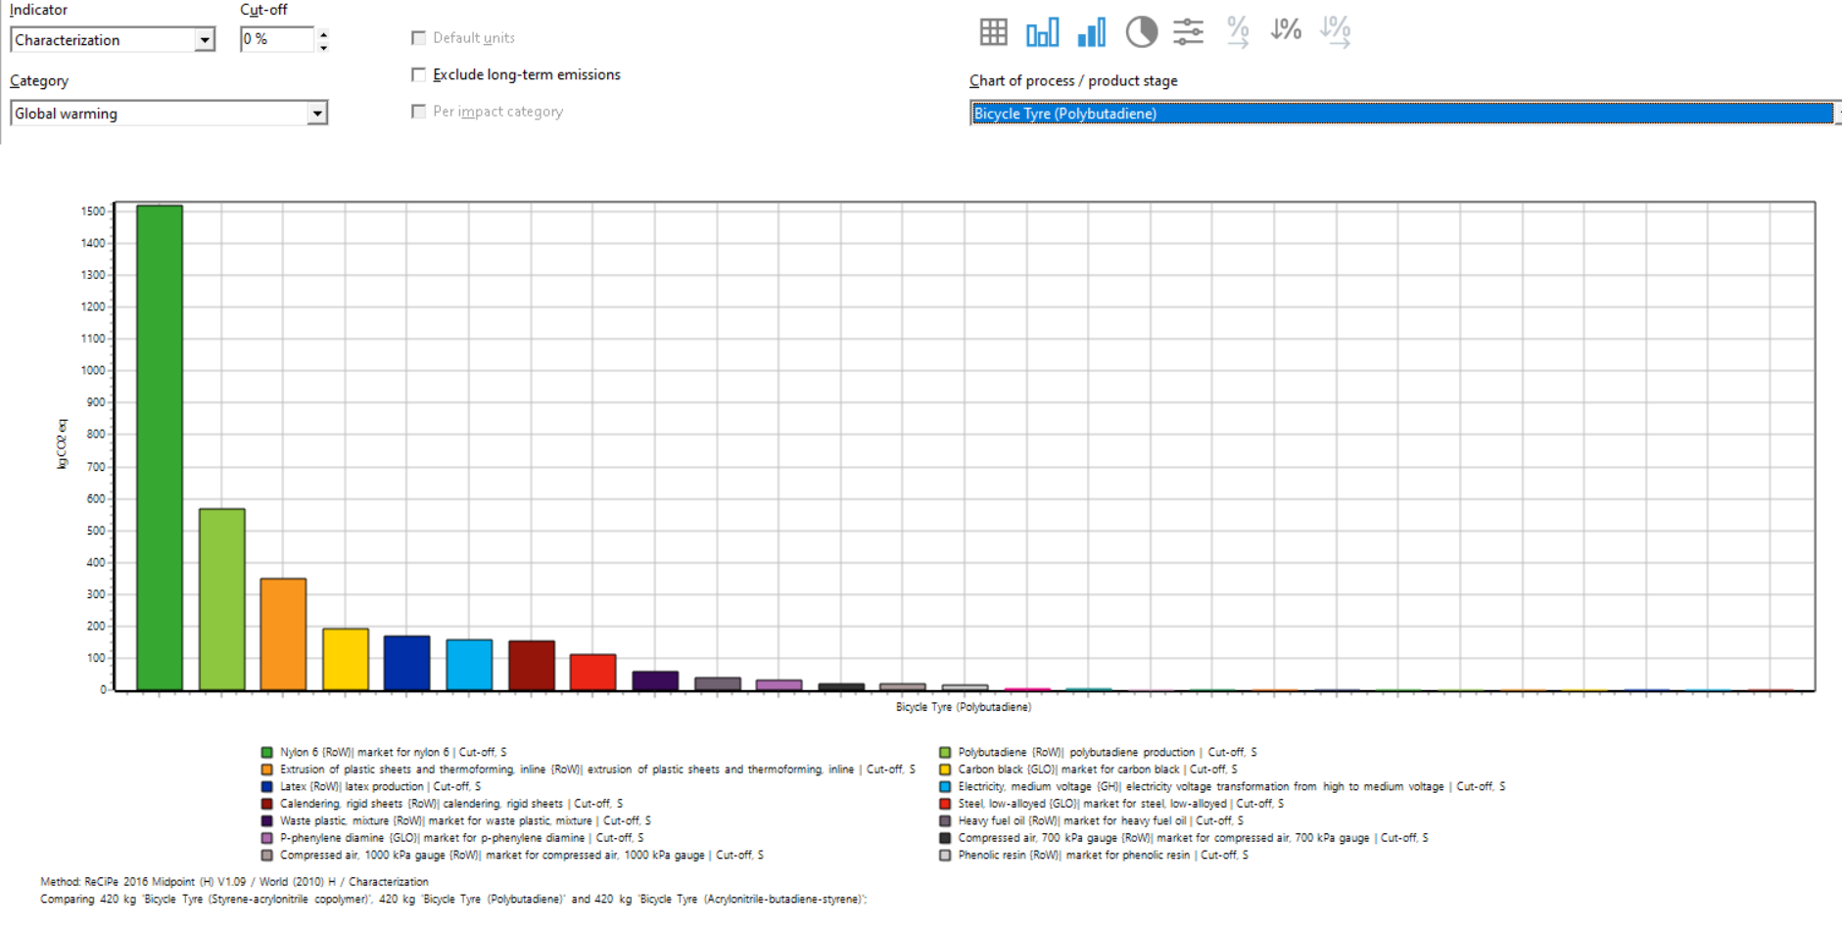
GLOBAL WARMING CONTRIBUTIONS, STYRENE-ACRYLONITRILE COPOLYMER

Slide 12
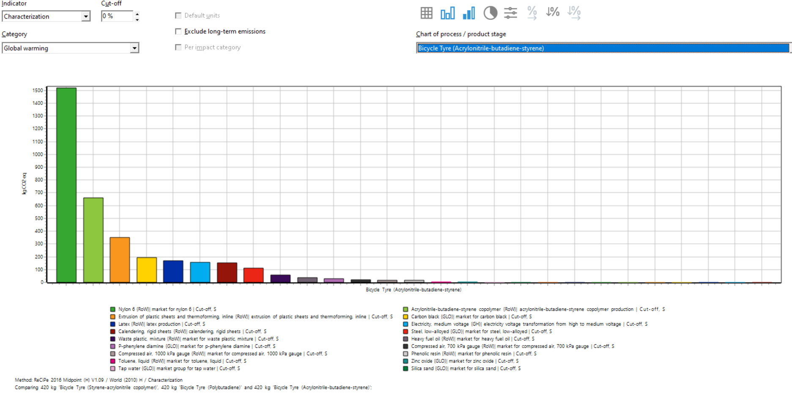
GLOBAL WARMING CONTRIBUTIONS, ACRYLONITRILE-BUTADIENE-STYRENE

Slide 13
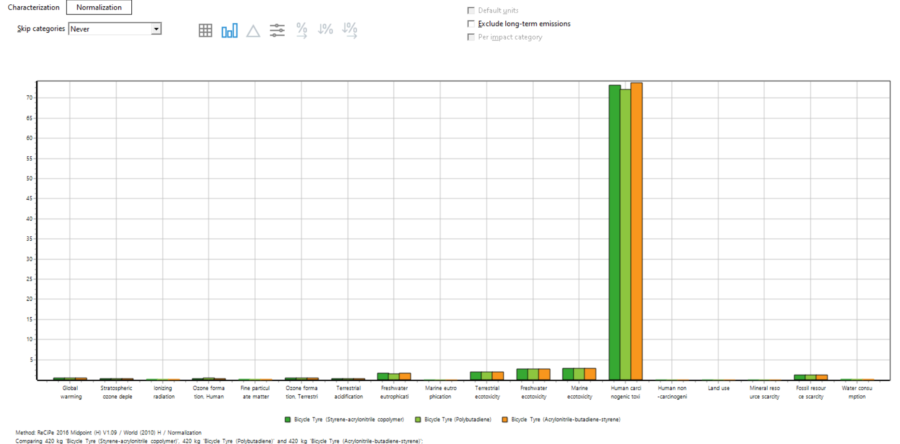
NORMALIZATION OF THE VARIOUS IMPACT CATEGORIES

Slide 14
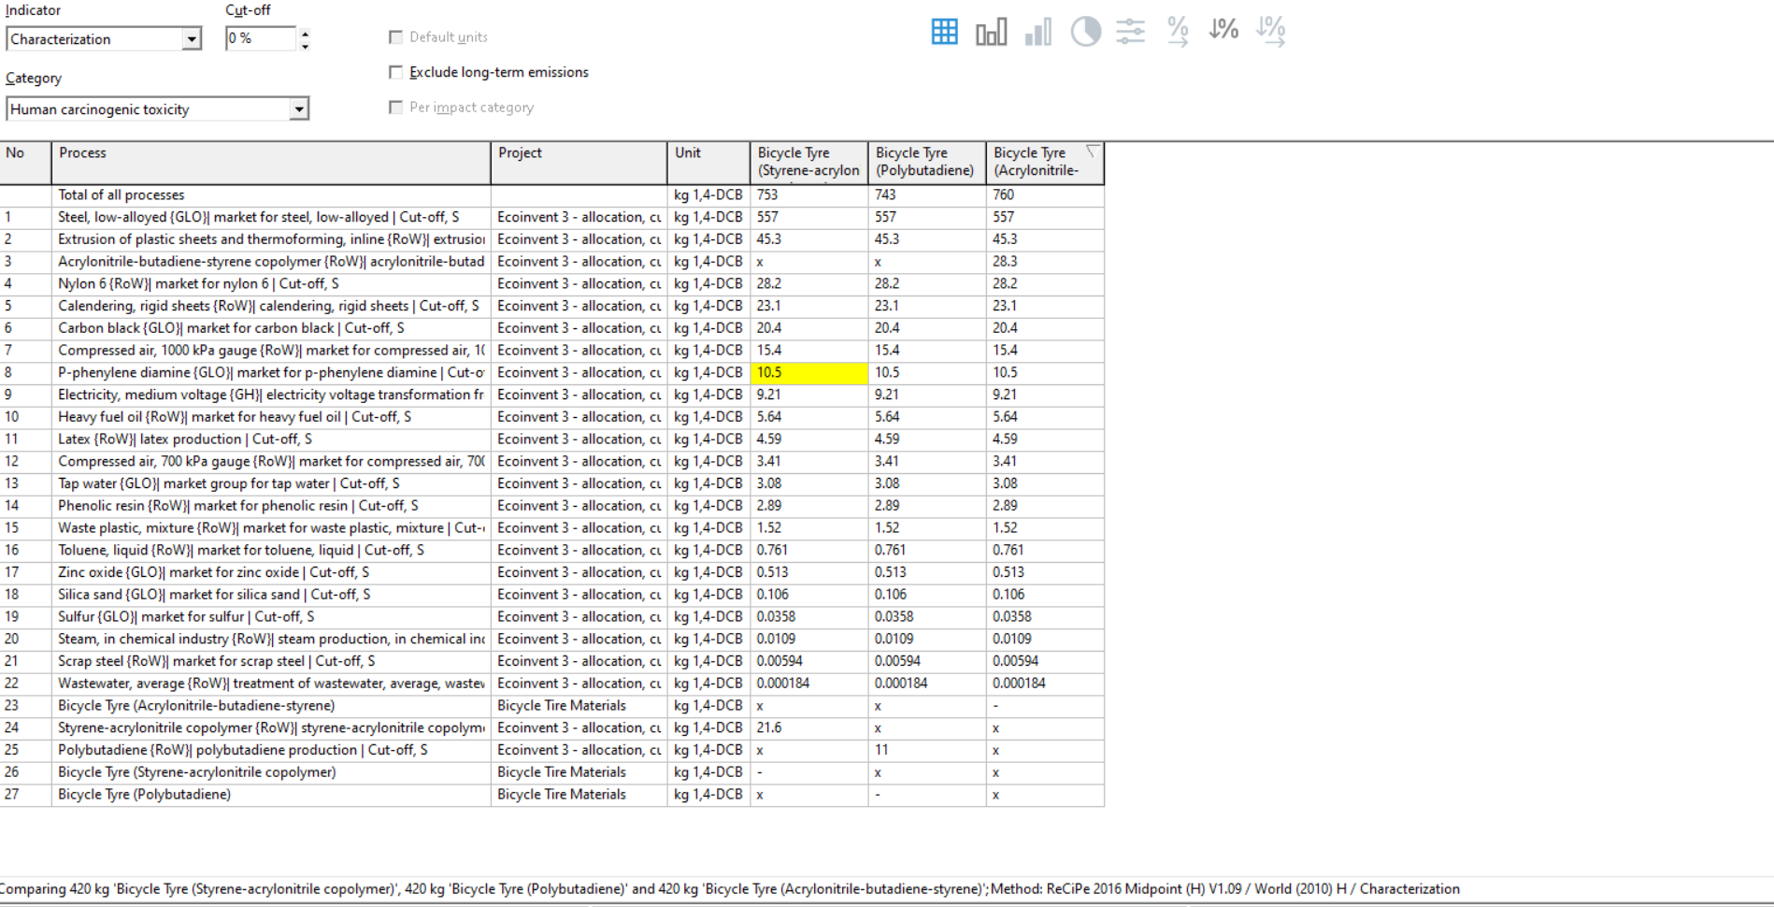
CONTRIBUTION TO HUMAN CARCINOGENIC TOXICITY

Slide 15
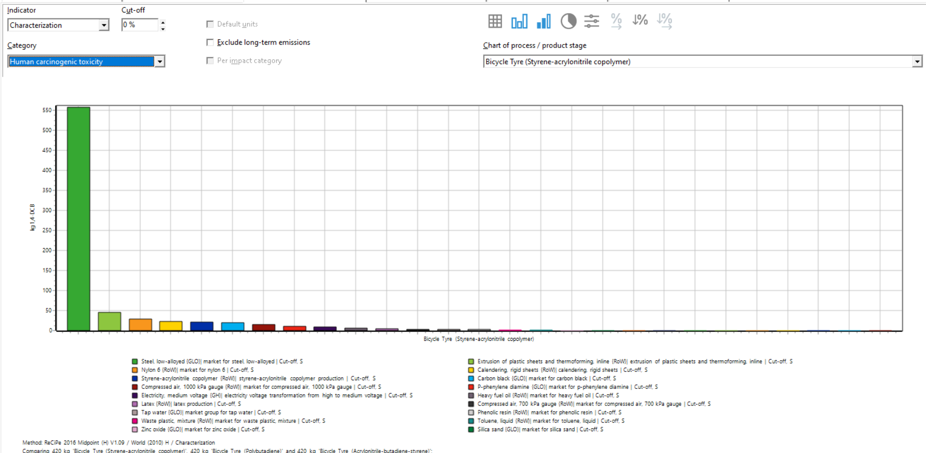
CONTRIBUTION TO HUMAN CARCINOGENIC TOXICITY

Slide 16
CONCLUSION
All the various scenarios showed minimal impact on global warming potential and other categories as compared to human carcinogenic toxicity
In respect to GWP, Acrylonitrile-butadiene-styrene copolymer showed more impacts followed by Styrene-Acrylonitrile copolymer with the major contributor in each case being the Nylon used as the carcass material
In all cases, steel used in the bead core contributed greatly to human carcinogenic toxicity

Slide 17
RECOMMENDATION
Alternative materials should be evaluated for their potential to replace steel in the bead core and the nylon in the carcass

Slide 18
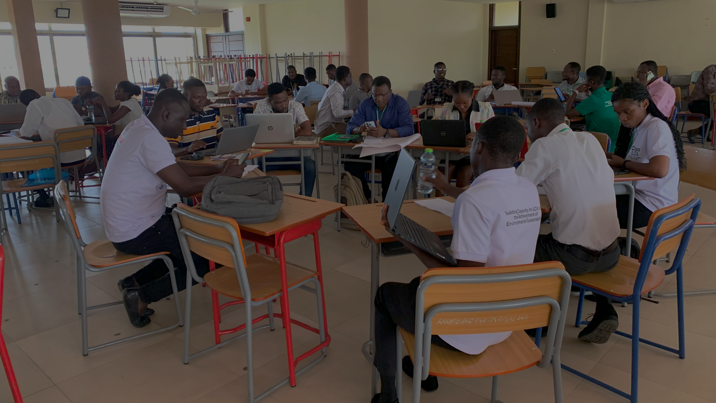
THANK YOU

